Slide 1

RATING ANALYSIS Project Synopsis Presentation Date: 12/10/21
Course Name (ECS 599)
Degree : B.TECH CSE (AI+ML+DL)
Project Guide:
Mrs. Neeraj Kumari
Assistant Professor(CCSIT)
AYUSH JAIN (TCA1959016)
FACULTY OF ENGINEERING & COMPUTING SCIENCES
TEERTHANKER MAHAVEER UNIVERSITY, MORADABAD

Slide 2

TEAM DETAIL
Student Name | Role
Ayush Jain | Developer
2
T011A/ Template Version 5.0

Slide 3

3
T011A/ Template Version 5.0

Slide 4
LANGUAGE/TOOL TO BE USED
Language
Python
JavaScript
Tools
VS code
HighCharts
Modules
PANDAS
JUSTPY
TKINTER
4
T011A/ Template Version 5.0

Slide 5
IMPLEMENTATION METHADOLOGY
In this Machine learning project , First you have to run the program in Visual studio code and then the program execute and first program display the size and shape of the dataset and then take input in number from 0 to 5 . According to the input you give to the system , it display the result in browser in the form of line graph and list with the labels.
5
T011A/ Template Version 5.0

Slide 6
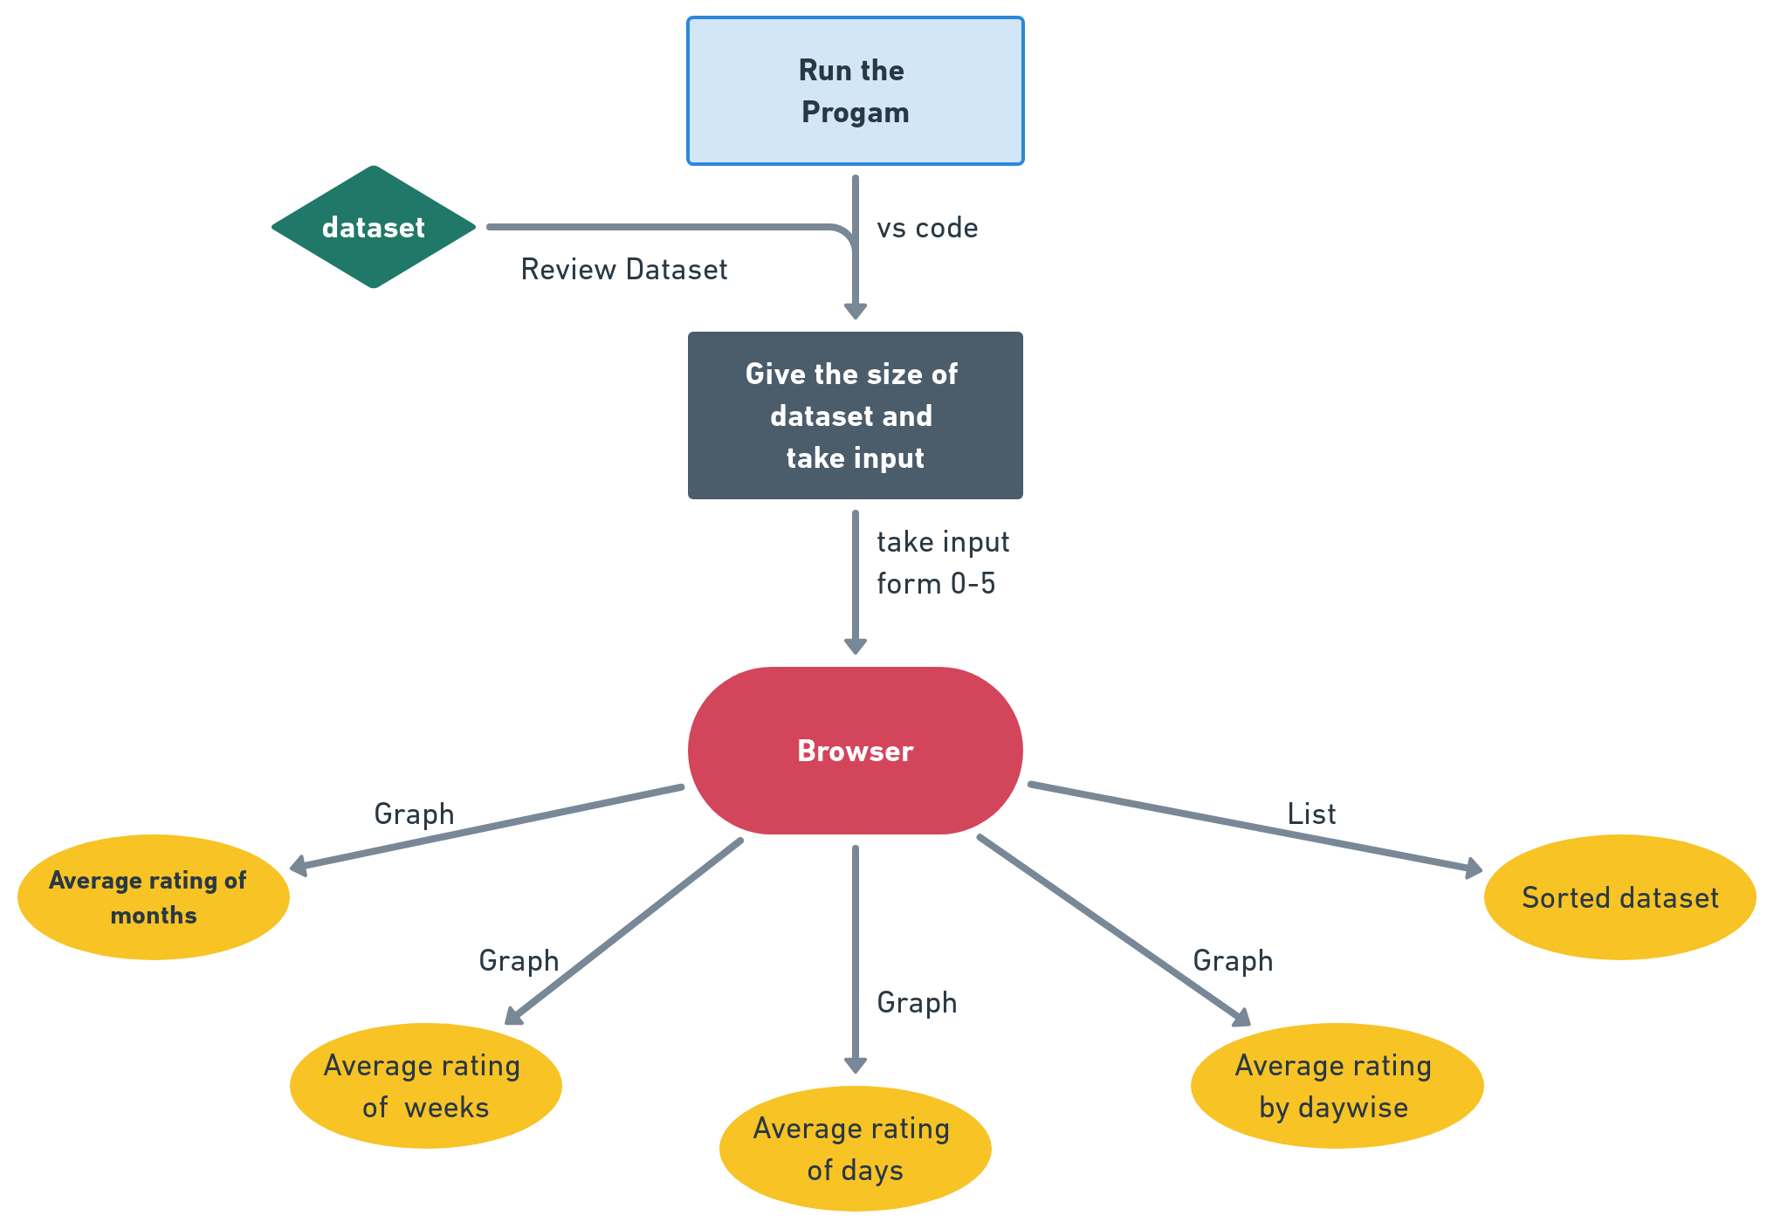
DATA FLOW DIAGRAM
6
T011A/ Template Version 5.0

Slide 7
\
ADVANTAGE OF THE PROJECT
Project give output by Plot the Average rating line graph by months , weeks, days and daywise.
This project sort the whole dataset which was easy to understand .
It saves the time and human efforts
It can do complex analysis which was difficult for us
7
T011A/ Template Version 5.0

Slide 8
Graphical
Outputs
8

Slide 9
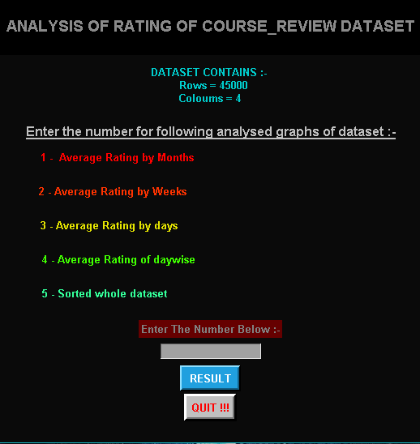
INPUT _PAGE
9

Slide 10
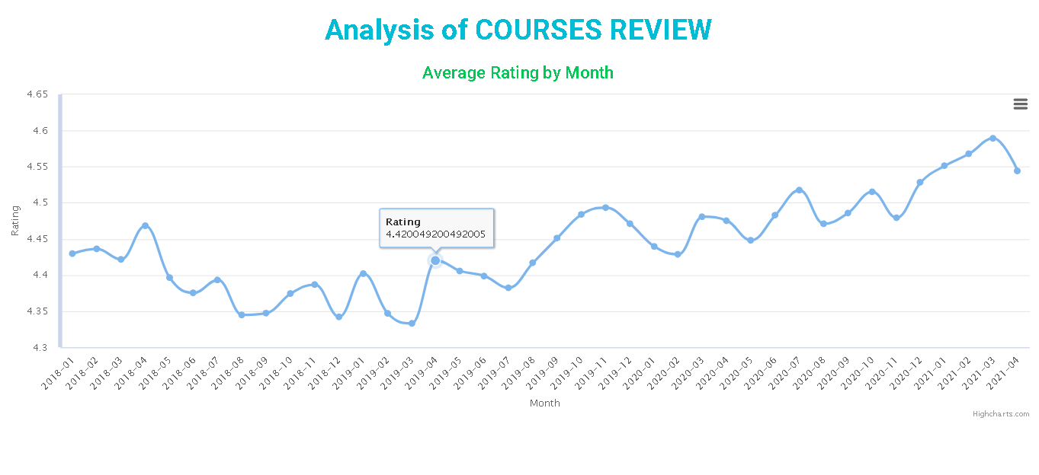
Graph of Months
10

Slide 11
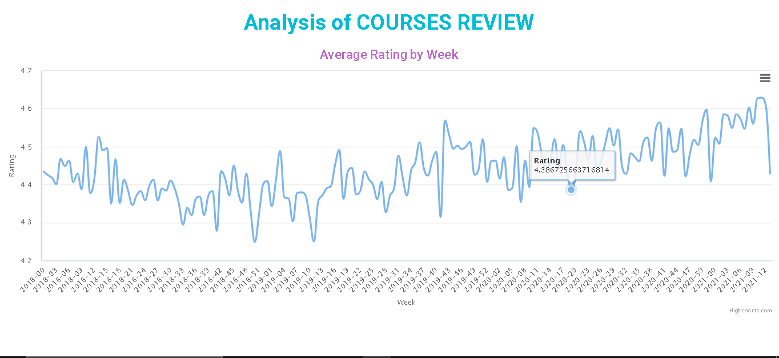
Graph of Weeks
11

Slide 12
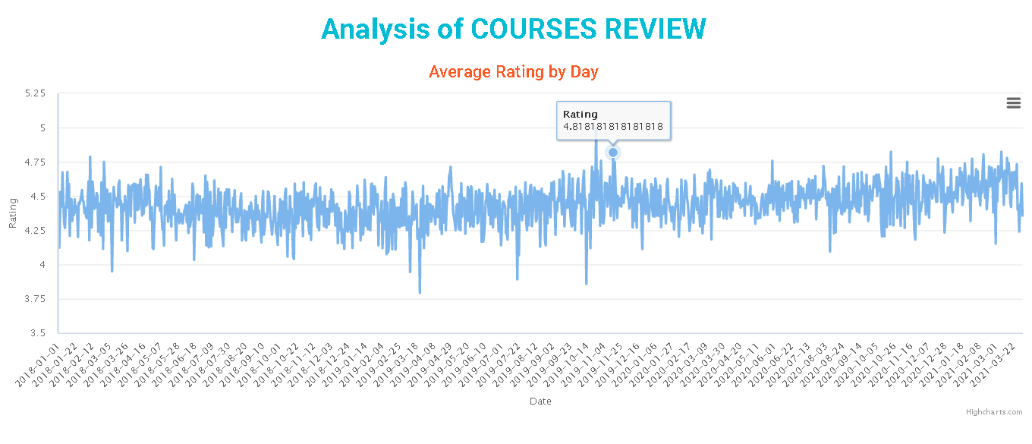
Graph of Days
12

Slide 13
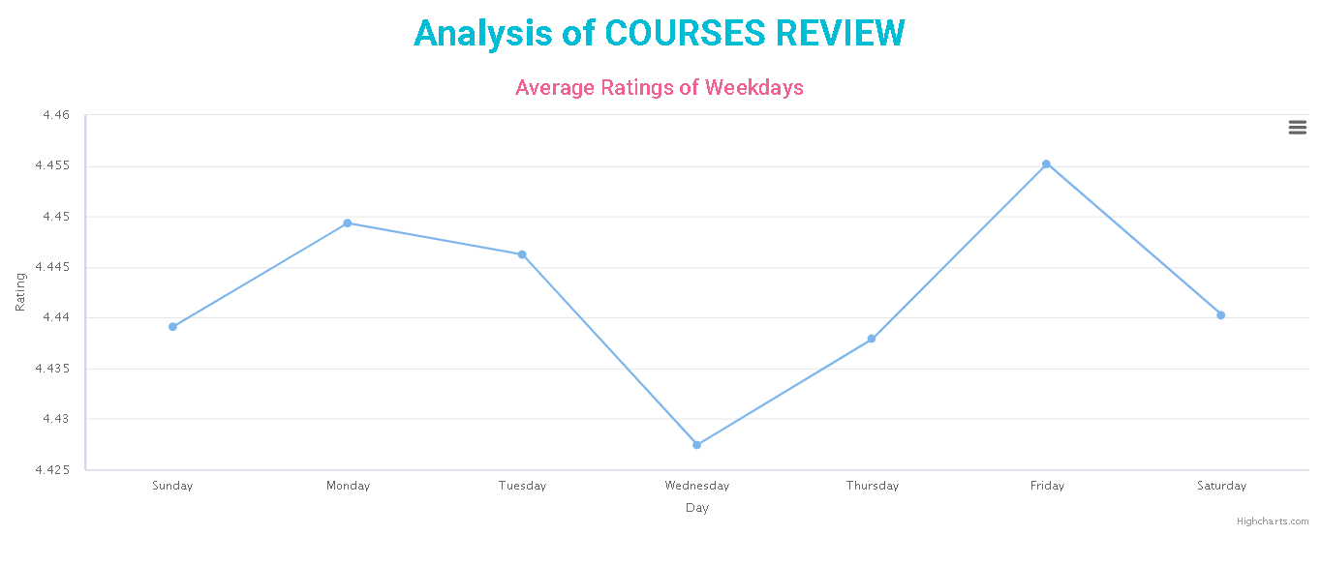
Day-wise Average Graph
13

Slide 14
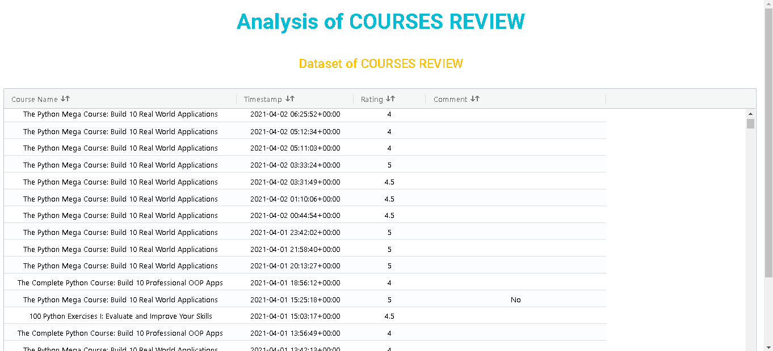
Sorted Dataset
14

Slide 15
FUTURE PLAN’S
Future enhancement is to add some more additional functionality such as:-
In future we can add more types of graphs and charts to make data analysis more accurately .
Beside Rating we can also add more attributes of the dataset in the future.
15

Slide 16
REFRENCES ,IF ANY
http://www.youtube.com
http://www.Udemy.com
http://www.internshala.com
16
T011A/ Template Version 5.0

Slide 17


